Slide 1

Coin Change Problem
( An application of dynamic programming)
DP is doing brute force smartly.

Slide 2
Problem statement:
You are given coins of different denominations and a total amount of money amount. Compute the fewest number of coins that you need to make up that amount. If that amount of money cannot be made up by any combination of the coins, return -1.
NOTE: you have infinite no of coins of each denominations mentioned in the problem.

Slide 3


Let's pay using minimum no of coins
I have 1, 2, 5, 10 rupees coins
Give me 20 Rs for the juice

Slide 4
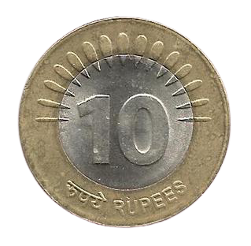
Thanks
Here is ur 20 rs

Slide 5
Different ways to solve this problem
Brute force method
Greedy approach
Divide and conquer ( coupled with dynamic programming )

Slide 6
Brute force method
Given four denominations Rs 1, Rs 2, Rs 5, Rs 10 assume we take a, b, c, d number of coins of 1, 2, 5, 10 denominations then n = a*1 + 2*b + 5*c + 10*d such that (a + b + c + d) is minimum.
- at most there can be n coins each of Rs 1. - Try all combinations where a <= n, b <= n, c <= n and d <= n. - Choose all valid combinations that give n = a + 2*b + 5*c + 10*d - take the minimum valid (a+b+c+d) combination as the answer.
Time complexity: ??
Space complexity: ??

Slide 7
Greedy method
If( n >= 10) take one 10 rupee coin and solve for ( n – 10) else if( n >= 5) take one 5 rupee coin and solve for (n – 5) else if( n >= 2 ) tale one 2 rupee coin and solve for (n – 2) else we take n coins as 1 rupee coins
For some combination of denominations this approach might always give optimal result. Consider a combination of 1, 5, 10 and 25 rupee coins. ( Prove this)
For some combination of denominations this approach may or may not give optimal answer. Consider n = 15, and denominations are ( 1, 7, 10).

Slide 8
Divide and conquer ( Dynamic Programming)
n
Int solve( int n ) {
If( n == 0 ) { return 0; } ans1 = ans2 = ans3 = ans4 = INT_MAX; if ( n >= 10 ) ans1 = 1 + solve( n – 10); if (n >= 5) ans2 = 1 + solve( n – 5); if (n >= 2) ans3 = 1 + solve( n – 2); ans4 = 1 + solve( n - 1); return min ( ans1, ans2, ans3, ans4); }
n -10
n - 5
n -2
n - 1
n –10 -10
n –10 - 5
n – 10 - 2
n –10 - 1

Slide 9
Divide and conquer ( Dynamic Programming)
n
Int solve( int n ) {
If( n == 0 ) { return 0; } if (dp[n] != -1 ) return dp[n]; ans1 = ans2 = ans3 = ans4 = INT_MAX; if ( n >= 10 ) ans1 = 1 + solve( n – 10); if (n >= 5) ans2 = 1 + solve( n – 5); if (n >= 2) ans3 = 1 + solve( n – 2); ans4 = 1 + solve( n - 1); return dp[n] = min ( ans1, ans2, ans3, ans4); }
n -10
n - 5
n -2
n - 1
n –10 -10
n –10 - 5
n – 10 - 2
n –10 - 1
n – 5 -5

Slide 10

Thank you
someone@example.com

